Slide 1
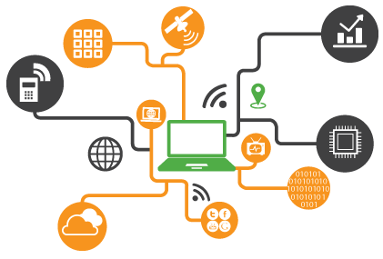
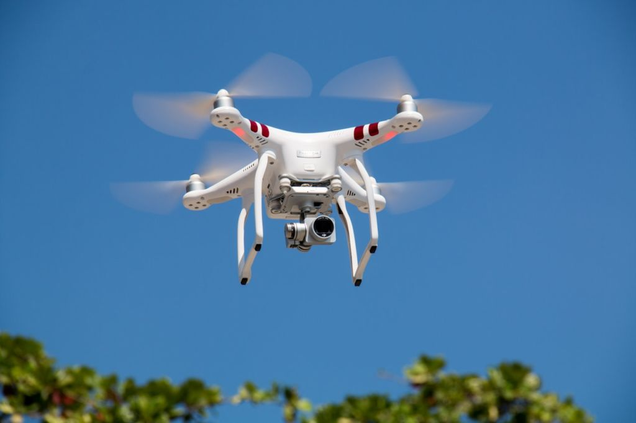
Autonomous Robotics Workshop
MSFEA Youth Summer Program 2019
Malek Itani

Slide 2
Outline
What is Autonomous Robotics
Introducing the Arduino
Sensors: Ultrasound and Distance Measuring
Actuators: Controlling a Motor
Obstacle Avoiding Rover

Slide 3

Autonomous Robotics
Accomplish repetitive, difficult or dangerous tasks
Self-correcting
Sensing the environment
No external influence
Intelligence

Slide 4
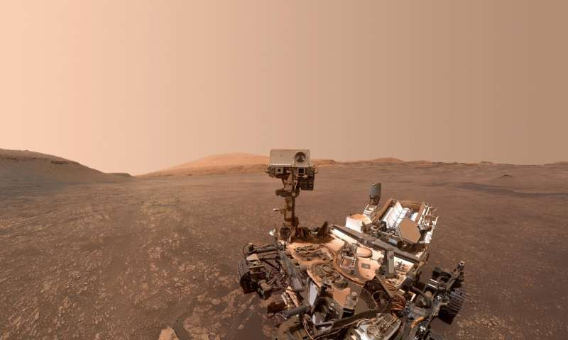

Slide 5
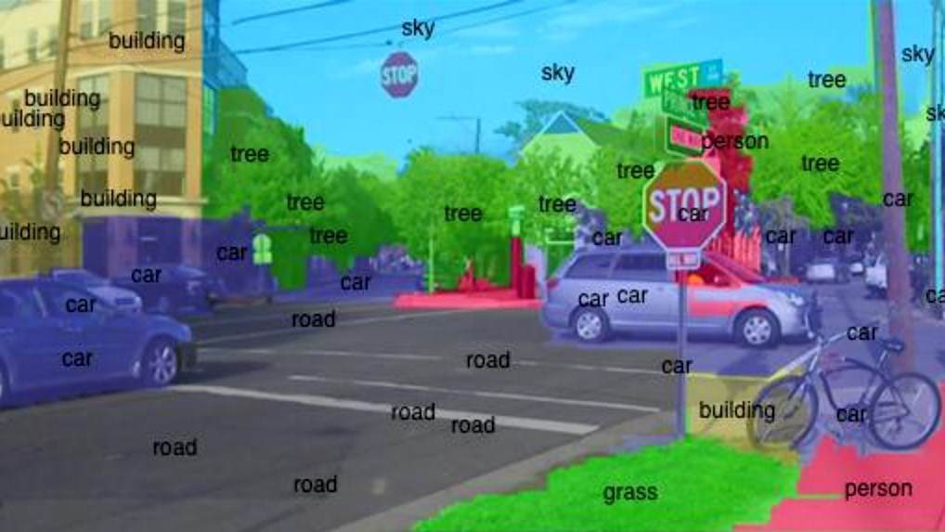

Slide 6
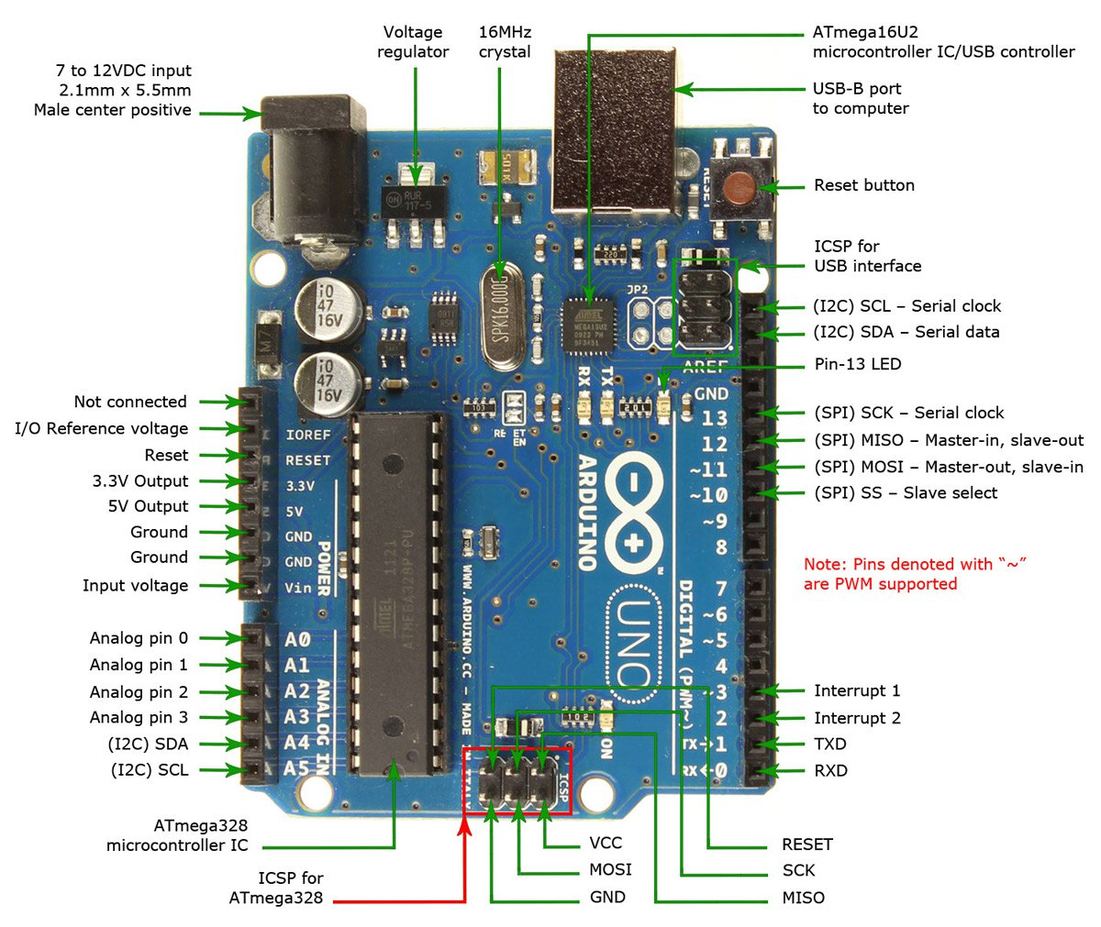
The Arduino
The Brain
Development board, consists of a microcontroller.
Sketches (Arduino programs) are uploaded using a USB cable directly from your computer and they stay there until you replace them.
Diagram of an Arduino Uno
Notes:
1

Slide 7

The Arduino
Notes:
1

Slide 8
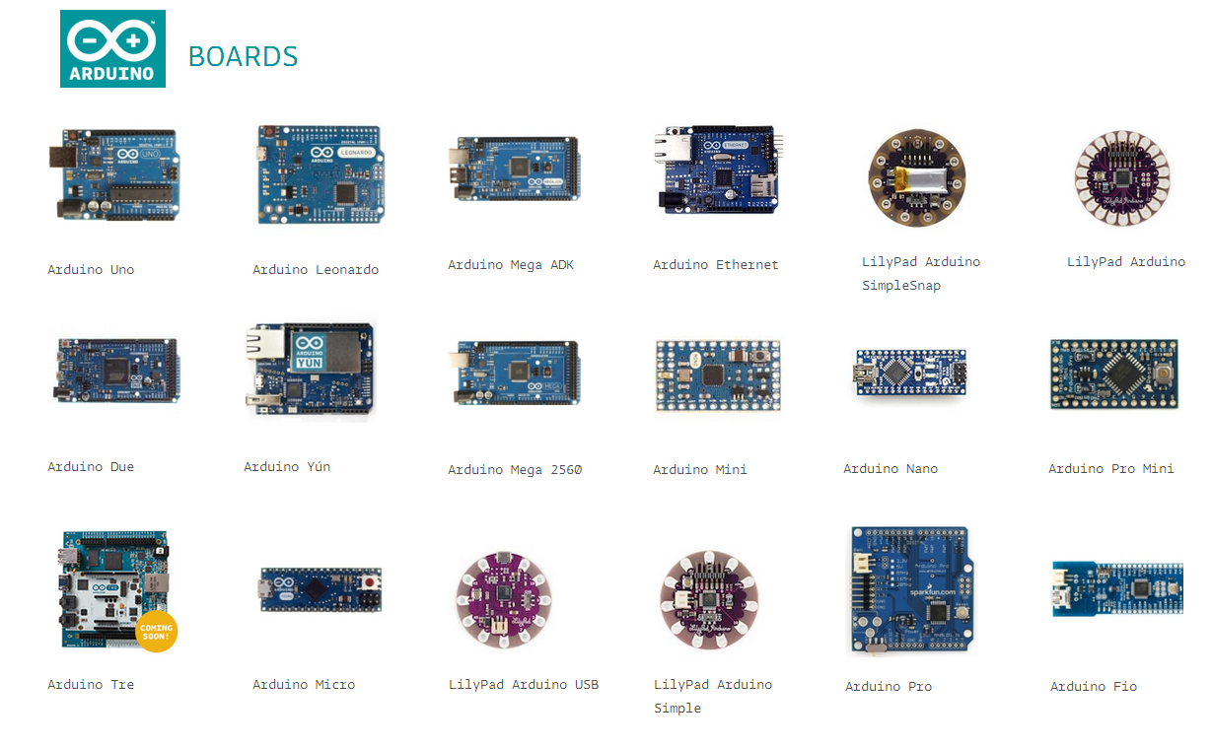
Many kinds of Arduino Boards:
Here’s ours:
Notes:
1

Slide 9
The Arduino IDE
Notes:
1

Slide 10
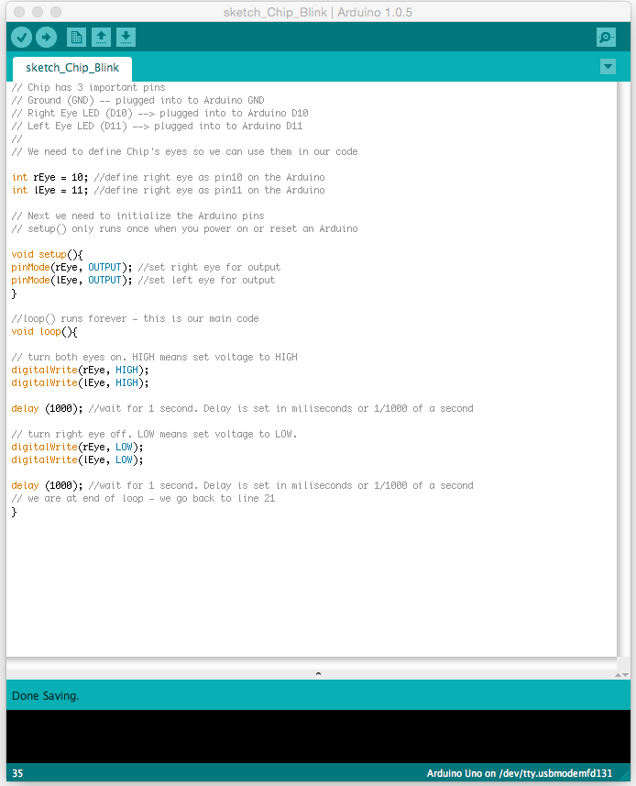
Blinking an LED
A Sketch is an Arduino program. It is written in C++ and uploaded onto the board. We write everything we want the board to do in the sketch.
Structure of a Sketch:
Setup function: initializes pin configurations, starts Serial communication, etc.
Loop function: control analog/digital pins, read from and write to serial port, and all kinds of other stuff.
An Arduino Sketch
Notes:
1

Slide 11
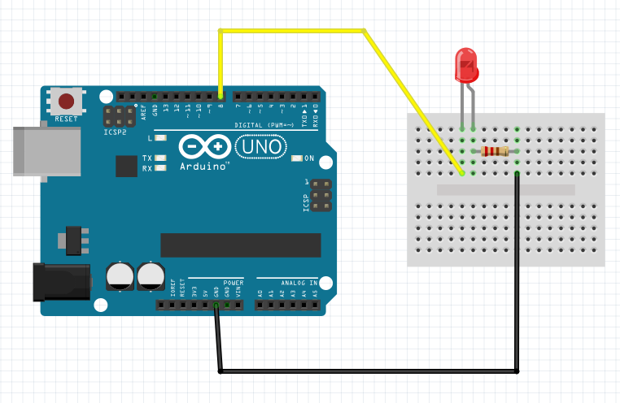
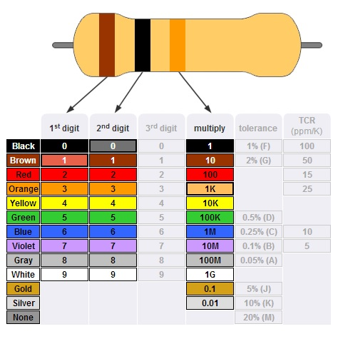
Blinking an LED
Resistor Color Codes
Circuit Diagram for LED
Notes:
1

Slide 12
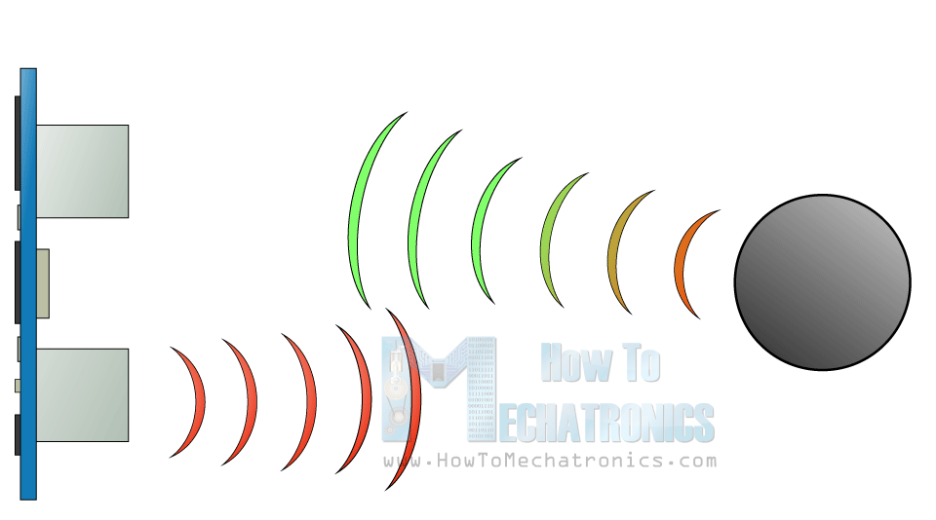
Sensors: Ultrasound and Distance Measuring
Notes:
1

Slide 13
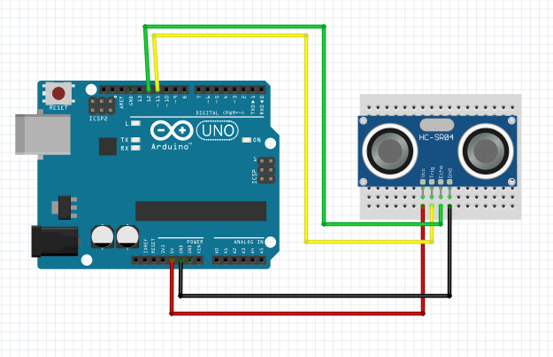
Sensors: Ultrasound and Distance Measuring
Circuit Diagram for Ultrasonic Sensor
Notes:
1

Slide 14
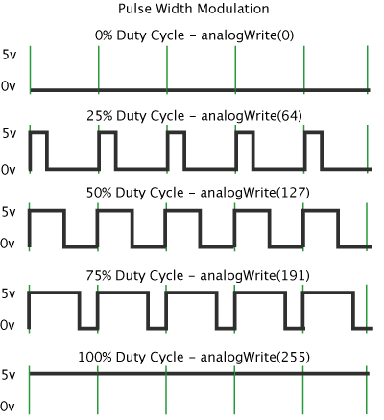
Concept: PWM (Pulse Width Modulation)
- A way of achieving analog results with digital means
- By changing the width of the “on-time”, we can get an output that can act like a value between 0V and 5V
- Implemented using the function:
analogWrite(int pin, int value);
Notes:
<number>

Slide 15
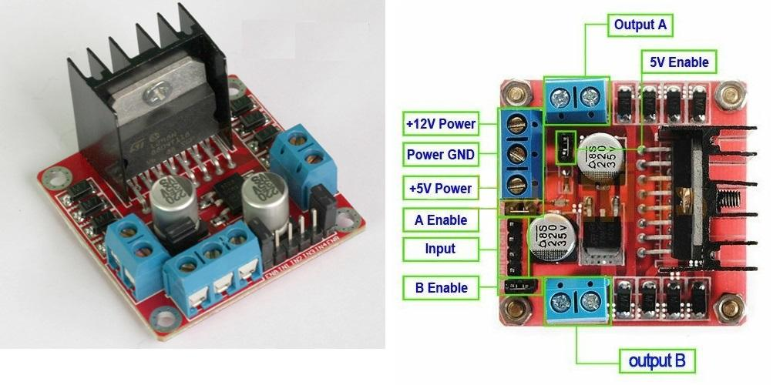
Actuators: Controlling a Motor
Notes:
<number>

Slide 16
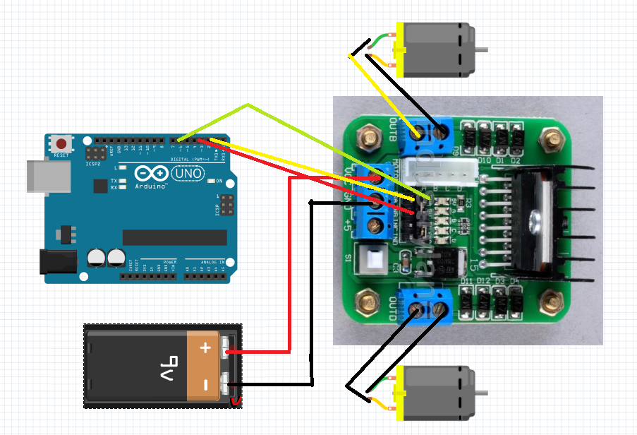
Actuators: Controlling a Motor
Notes:
<number>

Slide 17
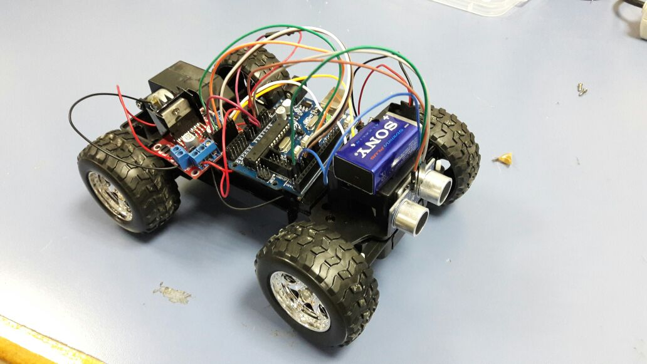
Obstacle Avoiding Rover
Notes:
<number>

Slide 18
Questions to think about
What should the rover do when there is nothing in front of it?
How should it act if there is something in front of it?
How much time should it take when doing this?
Are the passengers comfortable?
How do I implement this?
Notes:
<number>

